Slide 1
Semicolon Usage
Presented By: Hayley Lowry

Slide 2
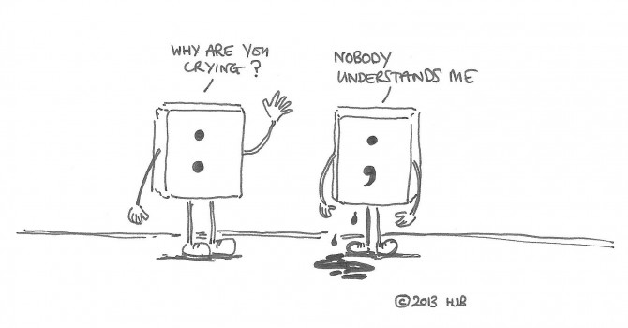

Slide 3
Why is it used; how do you use it?
1
“At a comma, stop at a little; at a semicolon, somewhat more.”
-Richard Hodges, The English Primrose

Slide 4
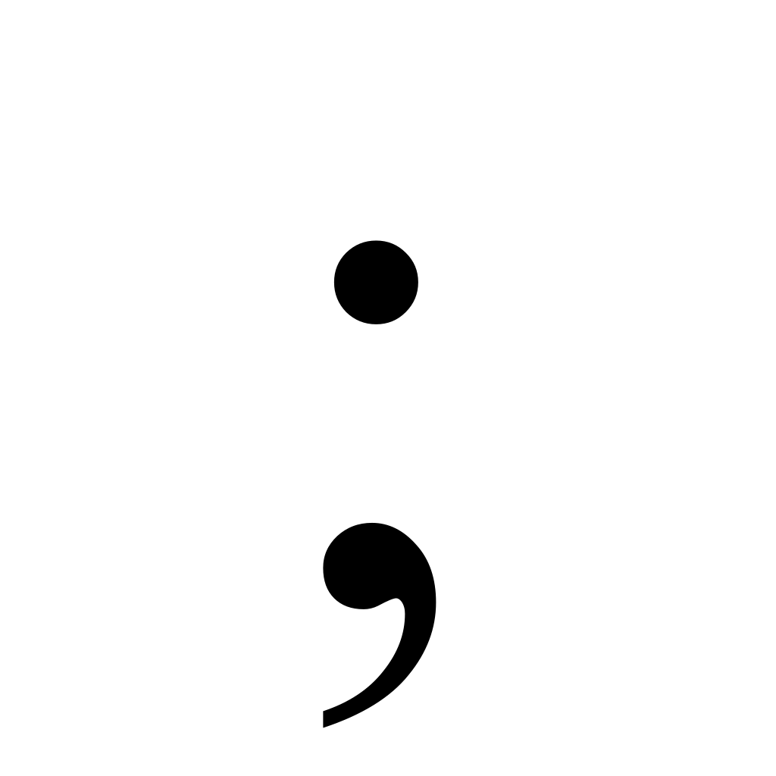
What is it?
Soft period, hard comma.
Mostly useful for programmers, honestly.
Useful for emphasizing relationship between ideas.

Slide 5
How do you use it?
Use a semicolon to join two independent clauses together in place of a coordinating conjunction (Or where one doesn’t exist).
EX:
I’m not a big fan of country music. I’m more into rock instead.
Can be rewritten as:
I’m not a big fan of country music; I’m more into rock instead.

Slide 6
How else can you use it?
Internal punctuation can easily get disorganized without one.
Between clauses linked by a transition word.
Today I woke up and chose violence, which was necessary; anger, which was called for; and destruction, which brought me peace.
I ate too much; therefore, I have a stomach ache.
There was an event being held nearby by my favorite author; however, I couldn’t afford to go.

Slide 7
Common Pitfalls
2
Most of the time, a semicolon is unnecessary, and too many can over-complicate your work.

Slide 8
What not to do:
Use the semicolon when a coordinating conjunction is present.
Link a dependent clause to an independent clause.
I love going outside in the rain; and the smell of grass after the rain is the best part!
My friends urged me to go out with them; but I was too tired that night to go out.
Because I love nature; I love to go outside and dance in the rain!
While I love reading; many people find reading to be a chore.

